Slide 1


Chapter 11
Copying a Virtual Machine
Virtualization Essentials

Slide 2
Chapter 11 Objectives
Understand the composition of a virtual machine
Examine using templates
Understand how to clone a virtual machine
Examine virtual machine snapshots
2

Slide 3
Cloning Virtual Machines
Virtual machines are composed of files
Configuration files that describe the virtual hardware (.vmx for VMware)
Disk files that contain data (.vmdk)
Additional files represent dynamic states or functions
Snapshot information
Paging file
Log files
Copying these files duplicates the virtual machine, including the (virtual) hardware and software
Some work must be done to ensure that the new virtual machine has a unique identity or network errors will result
3

Slide 4
Cloning Virtual Machines (II)
The text walks through the manual process
This is not the recommended method for cloning since it is prone to errors
Vendor management tools have automated options to duplicate virtual machines
Sysprep is a Windows-specific utility that can be used to automate the customization of a cloned virtual machine
Sysprep can alter device drivers and add applications in addition to providing identification information
4

Slide 5
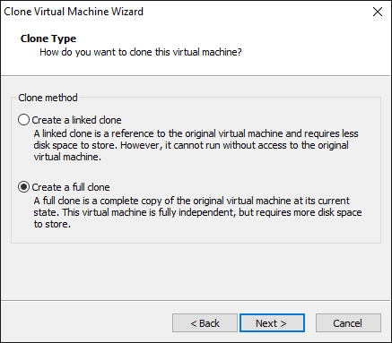
Virtual Machine Clones (III)
Full clones are replicas of the original virtual machine and require the same storage space
Linked clones use the original VM for reference, and any changes are kept in a delta disk
This requires much less space than a full clone though could cause performance issues depending on many factors
5

Slide 6
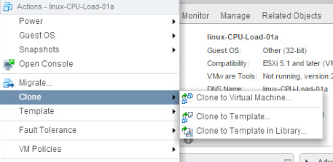
Virtual Machine Templates
Templates are models of virtual machines that can be cloned
Usually stored as virtual machines that cannot be powered on (read-only state) to help prevent unintended changes
Configured to be “golden images” (validated and approved combination of operating system with patches, corporate approved utilities, and sometimes application installations)
Templates are also created through the use of management tools
6

Slide 7
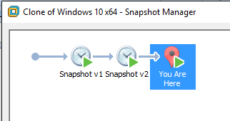
Working with Snapshots
Snapshots capture the entire machine state at a moment in time
Allows a user to make changes to the VM and then undo them by reverting to the snapshot
Not to be used as a backup solution due to potential performance issues
7

Slide 8
Working with Snapshots (II)
Snapshots lock the original virtual machine’s disk and create child a disk where changed blocks are written
When the user reverts to the snapshot, the child disk is erased, and the changes start again
Multiple snapshots can be taken, creating sophisticated branches of a development or test cycle
8

Slide 9
Working with Snapshots(III)
Deleting snapshots removes the child disk with the changes allowing the original disk to be written to once again
Merging the changes into the virtual machine (e.g., to add tested patches) collapses the changed blocks back into the original disk, which can be written to again
9

Slide 10
Chapter 11 Summary
Virtual machines are composed of files that contain VM configuration as well as data
Templates are used as molds to rapidly stamp out identical virtual machines
Cloning copies an existing virtual machine
Snapshots save the state of a virtual machine at a specific point in time that can be returned to over and over; they are a powerful tool for testing and development
10

